Slide 1

Airlines management system
Fly With Us Today!

Slide 2
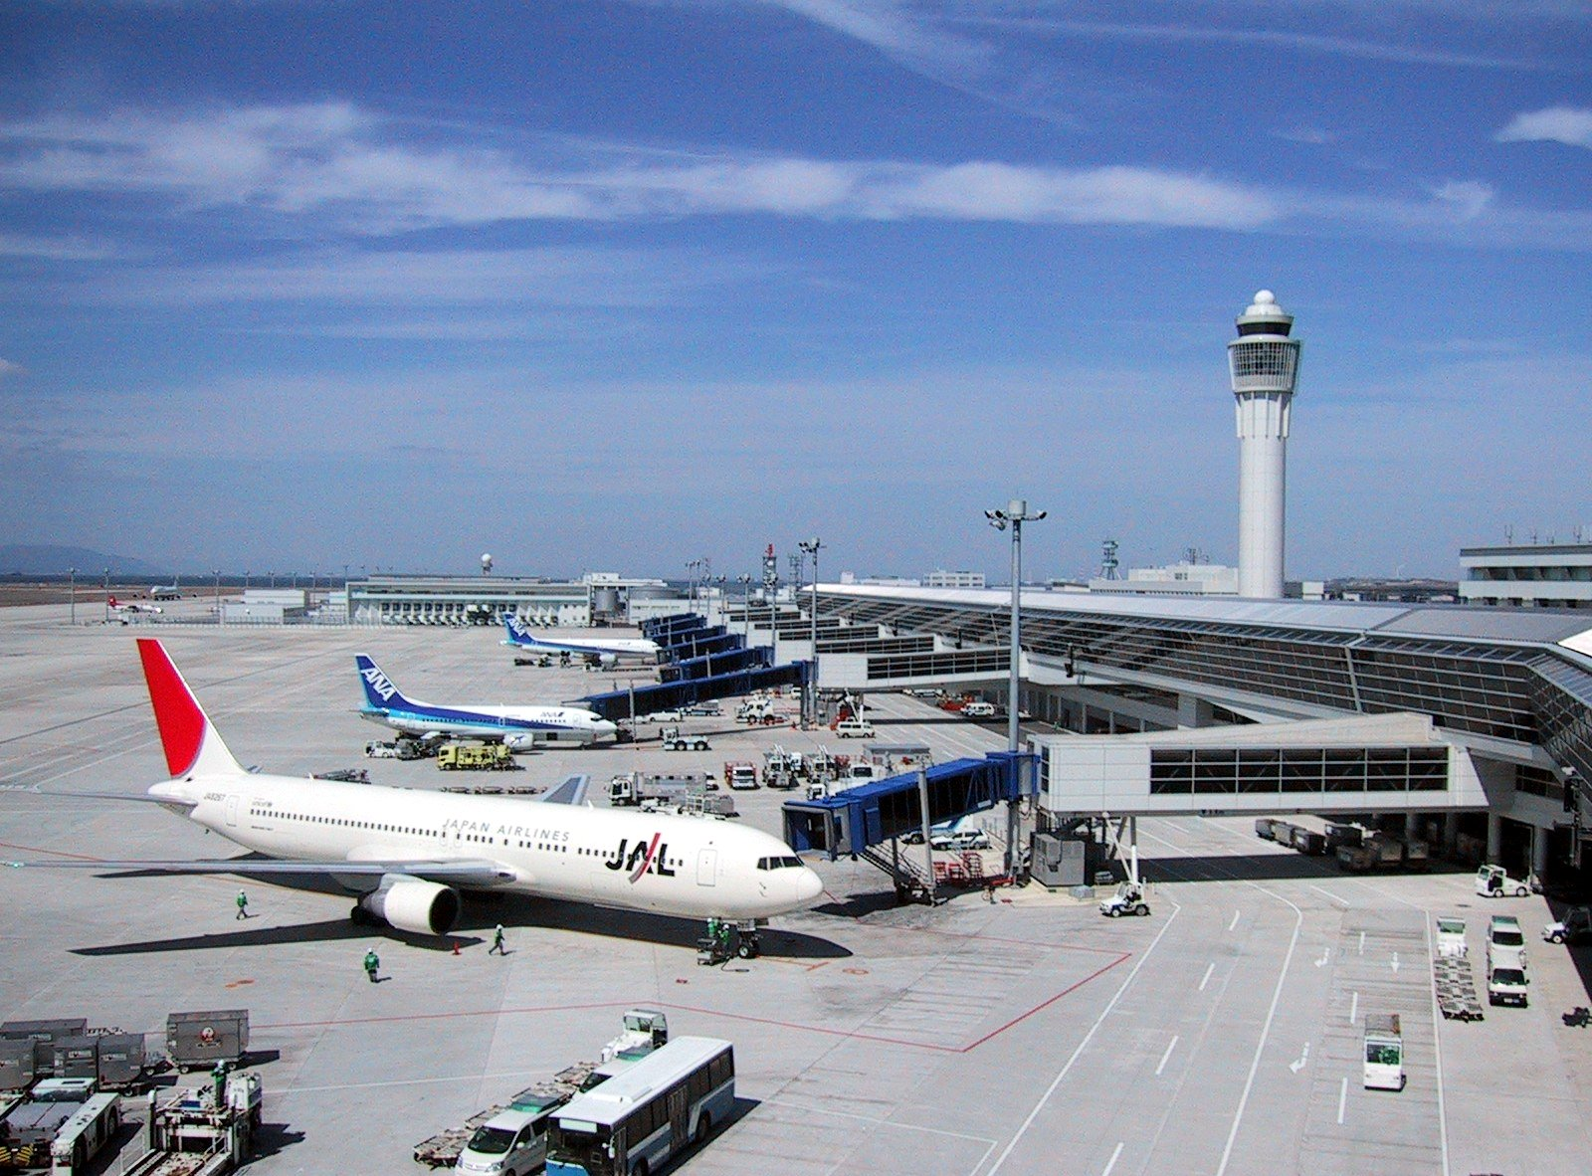
Presented by
Ahmed Shouman 19106873
Ammar Yasser 19106256
Farah Hesham 19104737
Salma Ashraf 19104695
Youssef Abdelkarim 19106386
Supervised by
Dr. Youssef Senousy
Eng. Ahmed Gamal

Slide 3

Project justification
An airlines management system is crucial for the smooth operation of an airline company. It can streamline operations, reduce costs, and improve customer satisfaction. It can help airlines comply with aviation regulations and maintain safety standards. Overall, an airlines management system is a critical investment for any airline company looking to improve its efficiency and profitability.

Slide 4

Product characteristics and requirements
1. Centralized Platform:
An airline management system should be a centralized platform that facilitates the management of various airline operations, including flight scheduling, ticketing, inventory management, crew scheduling, and maintenance scheduling.
2. Real-time Information:
The system should provide accurate and real-time information to the staff and passengers, enabling them to make informed decisions quickly.

Slide 5

Product characteristics and requirements
3. Regulatory Compliance:
The system should comply with aviation regulations and maintain safety standards to ensure the safety of passengers and crew.
4. Collaboration and Communication:
The system should improve communication and collaboration among the various departments of the airline company, leading to better decision-making and improved operational efficiency.

Slide 6



product user acceptance criteria
Functionality
Usability
The system should perform all the essential airline management functions, such as flight scheduling, ticketing, inventory management, crew scheduling, maintenance scheduling, and real-time information updates.
The system should be user-friendly, intuitive, and require minimal training for the staff to operate it effectively.
Reliability
Performance
The system should be reliable and available 24/7, with minimal downtime for maintenance or upgrades.
The system should perform efficiently, with fast response times and minimal delays, even under heavy loads.

Slide 7
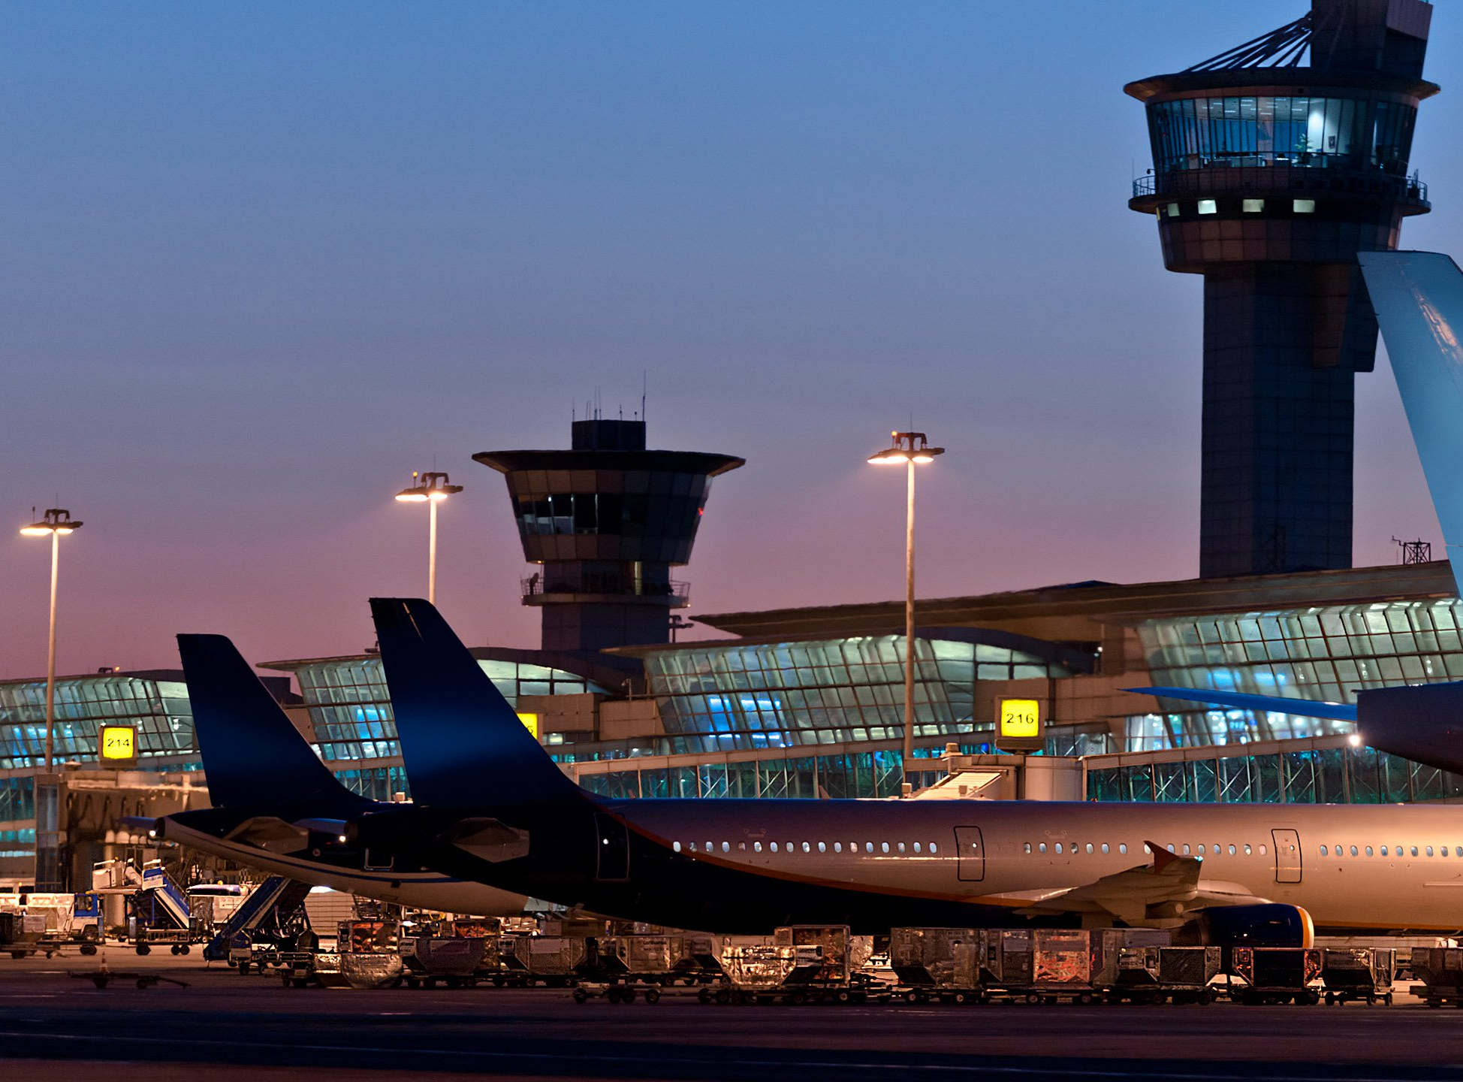
Summary of project deliverables
Fly easy.

Slide 8
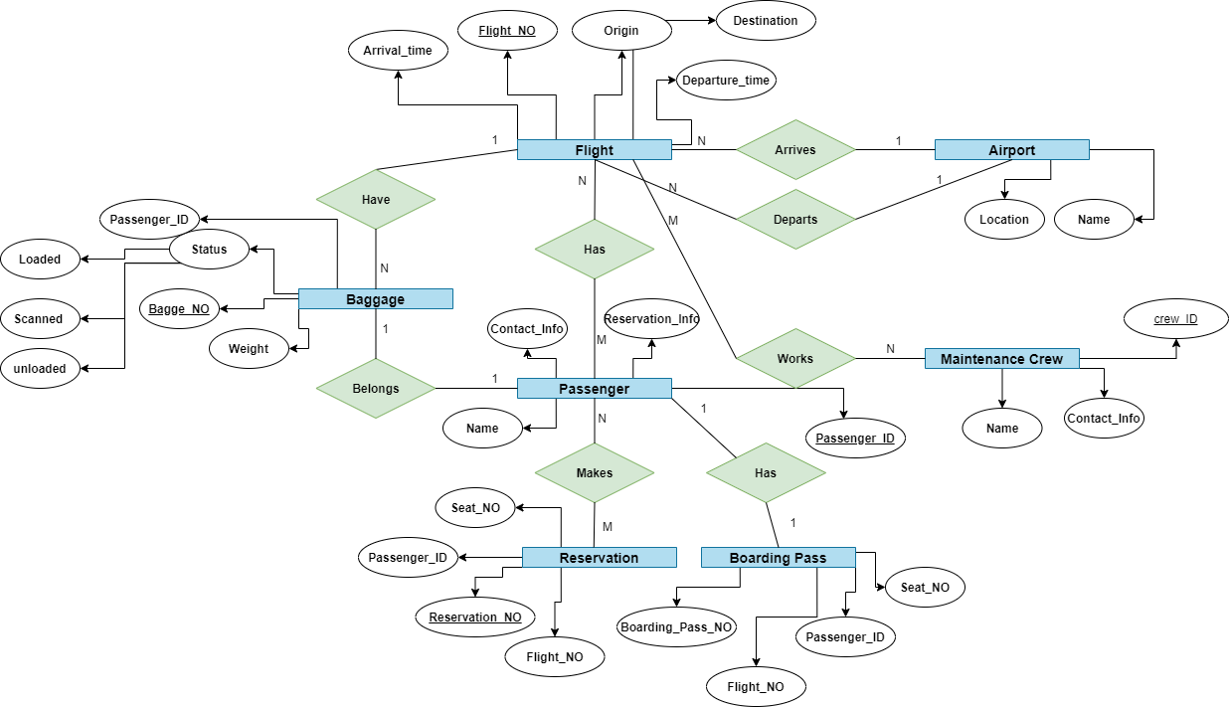
Project management-related deliverables – ERD

Slide 9
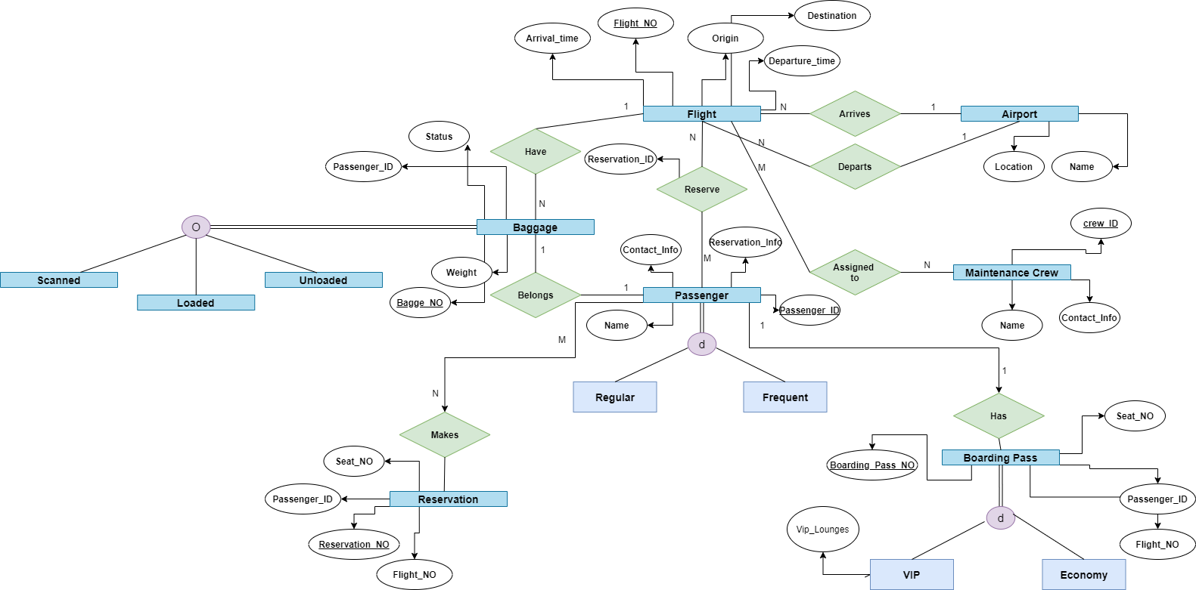
Project management-related deliverables – EERD

Slide 10
Project management-related deliverables – mapping
Entity | Primary Key | Attributes | Foreign Keys
Passenger | PassengerID | FirstName, LastName, Email, PhoneNumber, PassengerType | –
RegularPassenger | PassengerID | Address, PaymentMethod | –
FrequentFlyer | PassengerID | FrequenFlyerNumber, FrequentFlyerMiles | –
Flight | FlightID | DepartureAirportCode, ArrivalAirportCode, DepartureDateTime, ArrivalDateTime, AirlineCode | –
Seat | SeatID | SeatNumber, CabinClass | FlightID
Booking | BookingID | BookingDateTime | PassengerID, FlightID, SeatID

Slide 11
Project product-related deliverables – Software code

Slide 12

Thank you!
Have a safe landing.

